Slide 1



Forensics

Slide 2

Agenda
- Introduction/review
- What is forensics?
- Steganography:
- Files structure/formats & metadata
- Files carving/extracting
- Image steganography
- Network capture analysis
- Wireshark and how to read packets
- Memory Forensics (little glance)

Slide 3

Introduction/Review
Data encoding
Plaintext: CSC{flag}
Hexadecimal (Base-16): 4353437b666c61677d0d0a
Base64 (and other bases): Q1NDe2ZsYWd9DQo=
Binary: 01000011 01010011 01000011 01111011 01100110 01101100 01100001 01100111 01111101 00001101 00001010

Slide 4
Introduction/Review
Web requests
Method: GET/POST/PUT (etc…)
Request headers: includes information about the web request, sometimes even cookies or credentials, IP address, and other info.
Request body: Includes HTML code, PHP, JS, Media, POST forms, etc..
Common attacks: Directory brute forcing, malicious objects, etc.

Slide 5
Introduction/Review
Common Linux utilities
- file, strings, and other basic Linux commands
- Installing packages/tools
- Basic info about networking protocols
- Programing/scripting language (Python)
GOOGLING + COMMON SENSE ☺

Slide 6
Forensics
Digital forensics refers to investigating digital evidence created on a machine.
In the real cyber security applications, it’s mostly focused on analyzing logs, memory dumps, and disk images from real computers.
In CTFs, it’s focused on steganography, memory and disk analysis, sometimes android analysis, and even some reverse engineering.

Slide 7
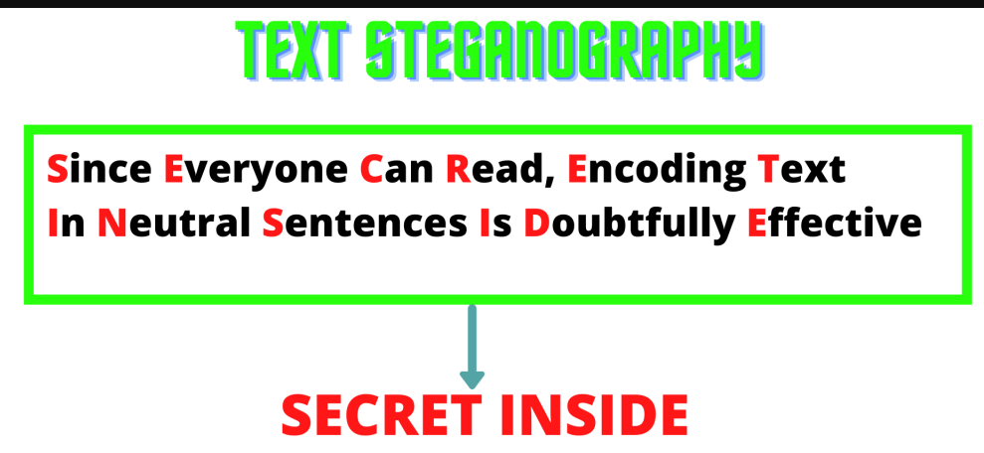
Steganography
Steganography refers to hiding a message inside another message.

Slide 8
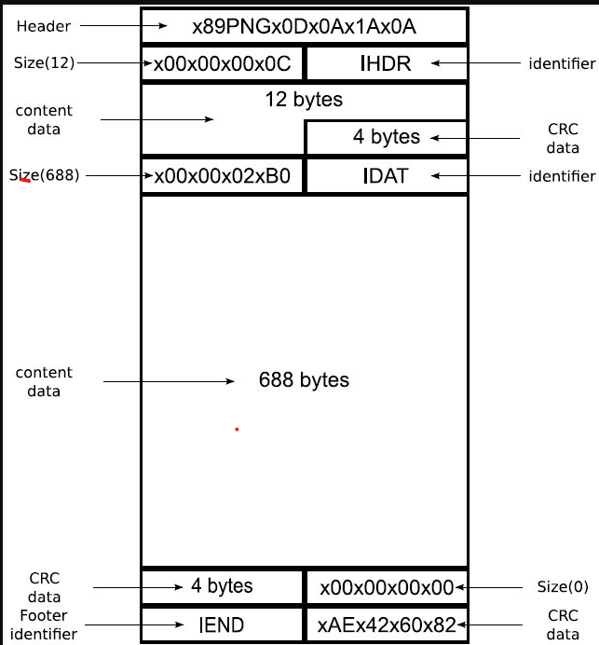
Steganography
How are files structured?

Slide 9
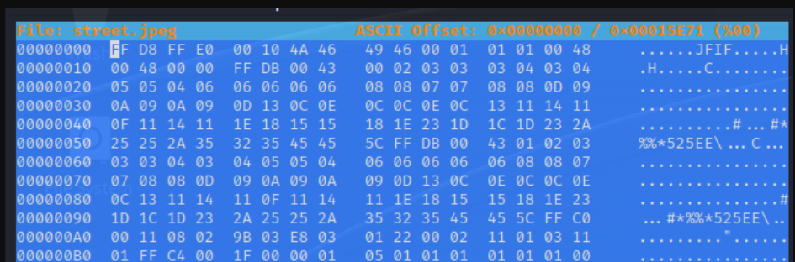
Steganography
A secret message could be hidden in different types of files. Let’s see how files work and how we could identify them.
First of all, almost all files have something called signature. A signature is a sequence of bytes at the beginning of the file.
We can see those bytes using a hex editor.

Slide 10
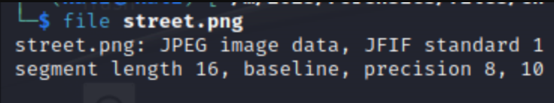
Steganography
Getting the file signature will help us get what type of file it is. However, the simplest way to know the type of file is by looking at its extension, but the extension isn’t always correct.
The command `file` shows us the type of file based on the signature, if the signature isn’t corrupt.
Notice how the command says “JPEG” even if the extension is “.png”.

Slide 11
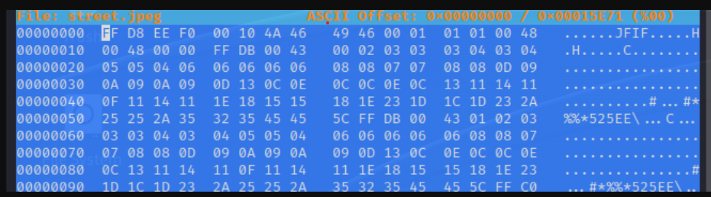
Steganography
We know the file signature, then what?
- Correctly identifying files
- Fixing corrupted files
https://en.wikipedia.org/wiki/List_of_file_signatures
The signature was modified at the third byte. The original signature starts with FF D8 FF E0, not FF D8 EE F0.

Slide 12
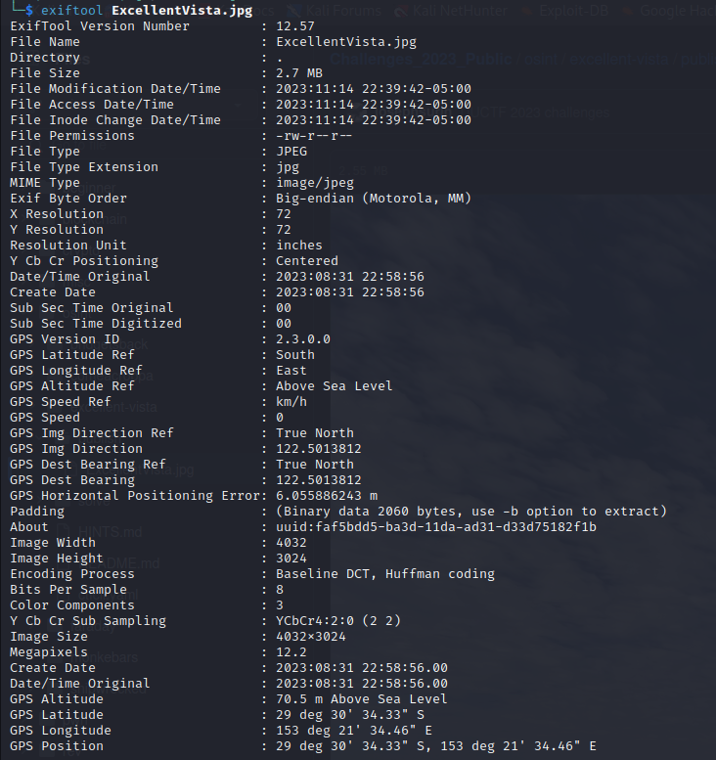
Metadata
Metadata is data about data. Metadata is usually attached with photos, videos, documents, etc. This could help us get the flag sometimes, or at least some hints about what we’re dealing with.
Example: We can see this image with its coordinates.
Which city was this image taken in?

Slide 13
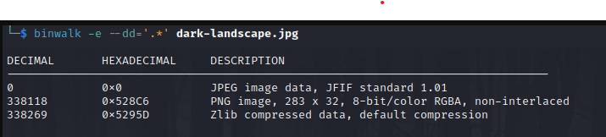
File carving/extracting
Sometimes some files are hidden inside other files. We can use the tool foremost (or binwalk if you want) to extract those files.

Slide 14
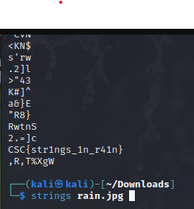
strings
Printable text inside the image/binary

Slide 15
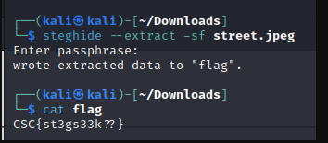
steghide
This is a tool that embeds (hides) files inside images but encrypts the file with a passphrase.

Slide 16
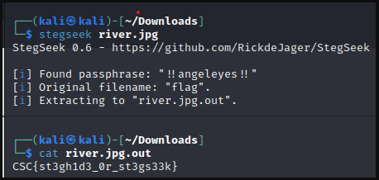
stegseek
This tool brute forces the passphrase to extract the files out of an image that have been hidden using steghide.

Slide 17
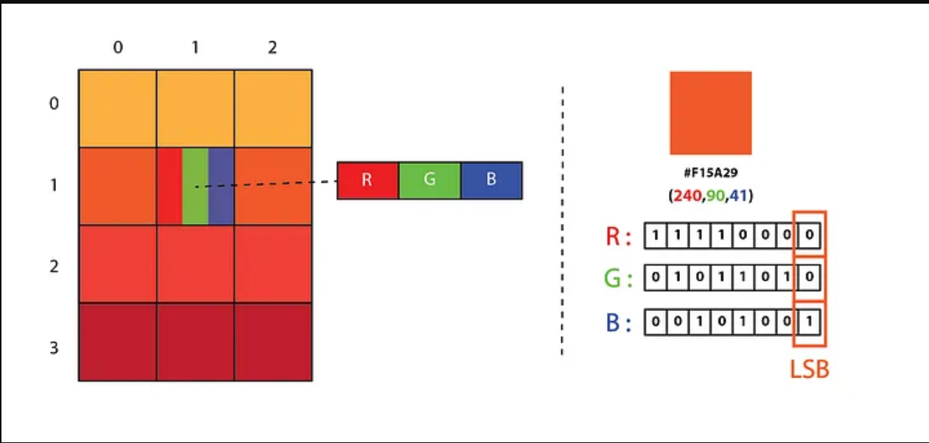
LSB (Least Significant Bit) steganography

Slide 18
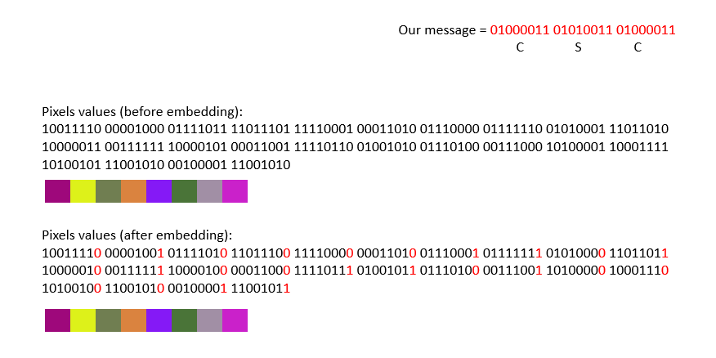
LSB (Least Significant Bit) steganography

Slide 19
Threat hunting and threat intelligence
Threat hunting is the process of finding undetected attacks in the network that managed to get into the network without being detected.
Threat intelligence is data collected about malware or any threat actor that can help in detecting malicious activity in the future.

Slide 20
Network analysis
PCAP file is s a network capture of a traffic for a period of time.
The traffic includes many protocols, including encrypted and plaintext traffic.
We can inspect the traffic using Wireshark

Slide 21
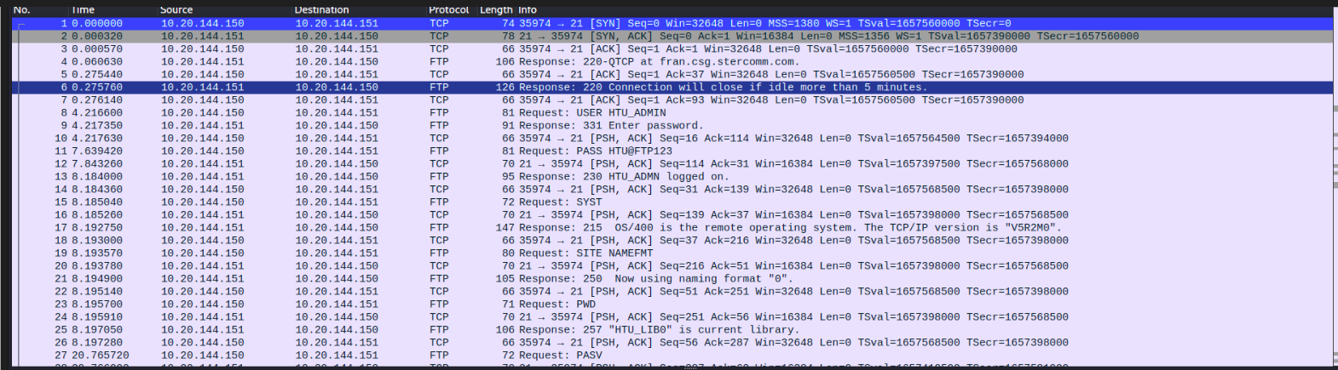
Wireshark example

Slide 22

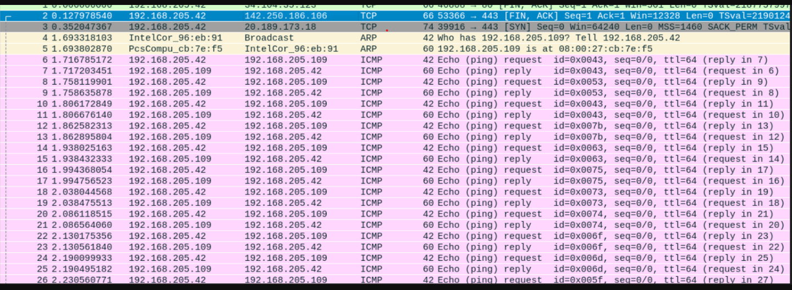
Wireshark example

Slide 23
Memory analysis
When an incident happens, let’s say a malware infected a machine, forensic experts gain a memory dump of the infected machine to analyze what happened.
A memory dump is an exact copy of the RAM.

Slide 24
Memory analysis
What does RAM include?
It includes anything that is currently being processed in the machine. Which includes:
- Processes
- Open files
- Open applications
- Registry keys
- OS information
- other stuff

Slide 25
Volatility
This is the tool that we’ll be using for memory forensics.
Those are the general steps for memory forensics:
- Identify the image profile (which operating system, version)
- Inspect processes (look for suspicious processes)
- Inspect files
- Check connections

Slide 26
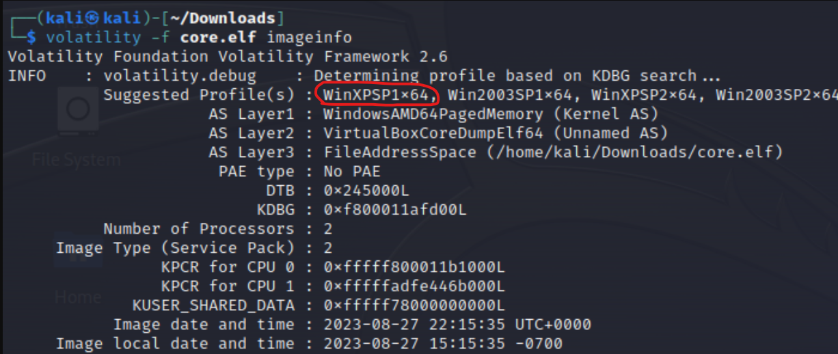
Image profile
We need the profile to tell volatility how to deal with the memory dump.
Syntax:
volatility –f <image_file> imageinfo

Slide 27
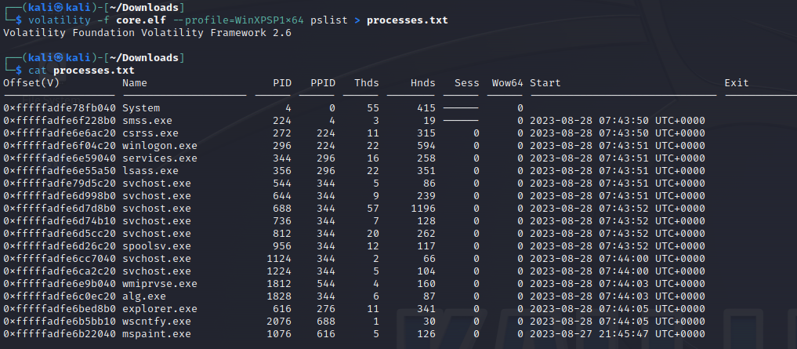
Processes list
Syntax:
volatility –f <image_file> --profile=<profile> pslist

Slide 28
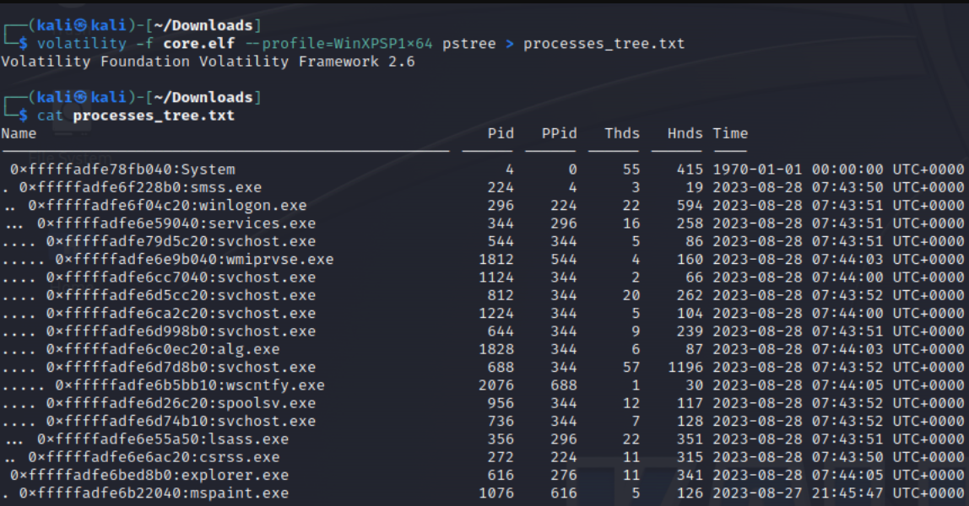
Processes list
Syntax:
volatility –f <image_file> --profile=<profile> pstree

Slide 29
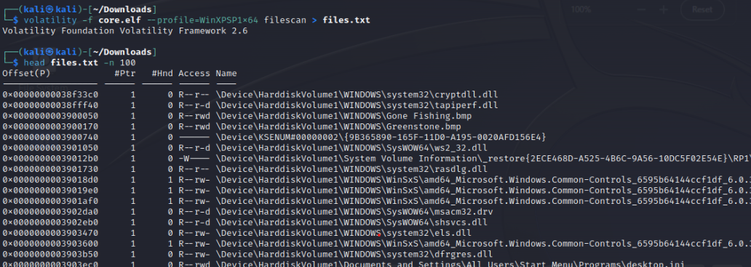
Files
Syntax:
volatility –f <image_file> --profile=<profile> filescan

Slide 30
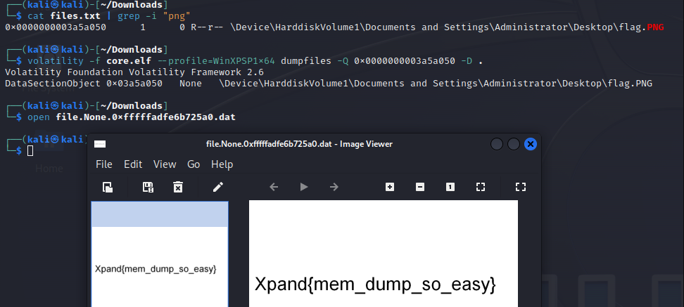
File dump
Syntax:
volatility –f <image_file> --profile=<profile> dumpfiles –Q <offset> -D <dump_dir>

Slide 31

Lab Time

